Slide 1
Your Trusted Partner in Accreditation
Admin Guide for Revamped Website - Overview
Sharon
AAD
24th June 2019
www.sac-accreditation.gov.sg

Slide 2

SAC Website Homepage

Slide 3
SAC Website Homepage
Homepage Hero Banner
Main Navigation Banner

Slide 4
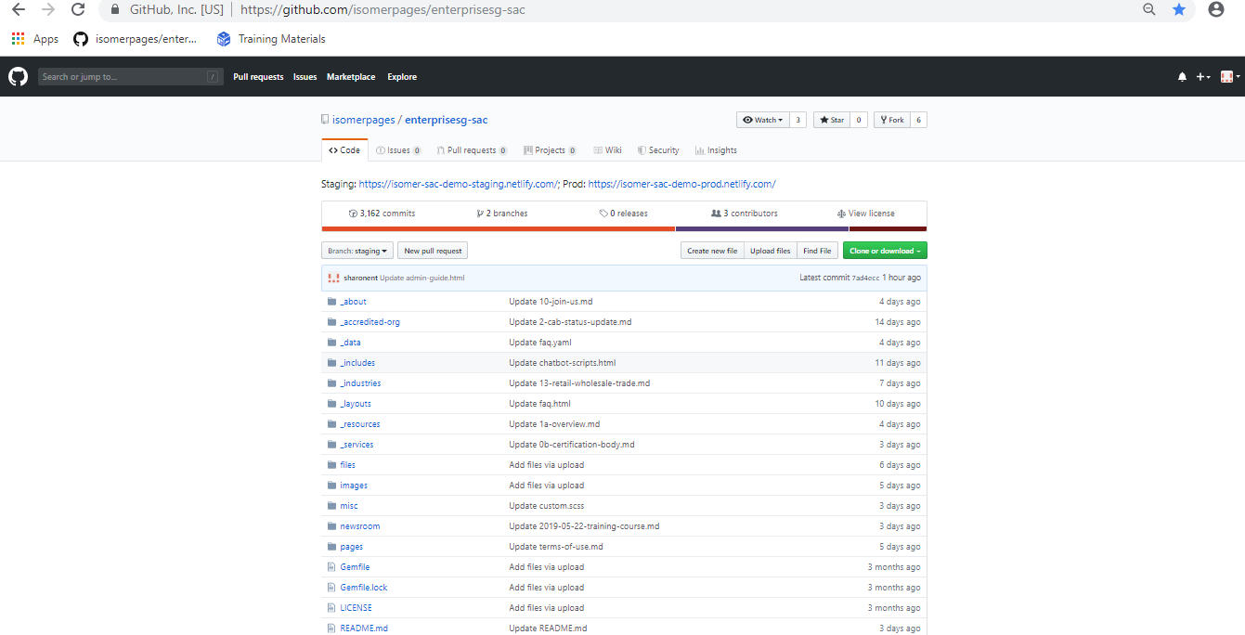
Github Repository

Slide 5
Github Repository
Link of the staging website
Make sure the branch is always set to ‘staging’ when you are editing anything

Slide 6
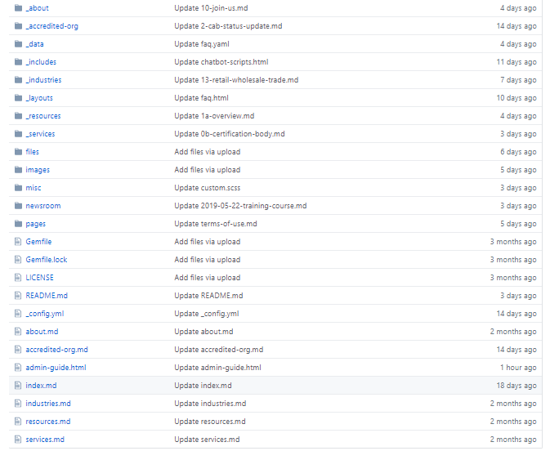
Github Repository
Each navigation link in the SAC website main navigation banner contains a folder of all the sub-pages, e.g. ‘about’, ‘accredited-org’, ‘ services’
Each main navigation link also contains a markdown (.md) file that contains information about the layout, title and url (e.g. about.md, accredited-org.md)

